Slide 1
Computational Studies of Pairwise Interactions in the CO/Pt(111) System
A J Gordon-Wright
Department of Physics, University of Bath ajgw20@bath.ac.uk
Physics Placement Conference
25th – 26th January 2010

Slide 2
Contents
The CO/Pt(111) System
History
The ISF
Challenging Results
Aims and Objectives
Condensed Matter Theory Group
DFT
MC Simulations
MC Method
Data Analysis Technique
Results
Analysis
Summary

Slide 3
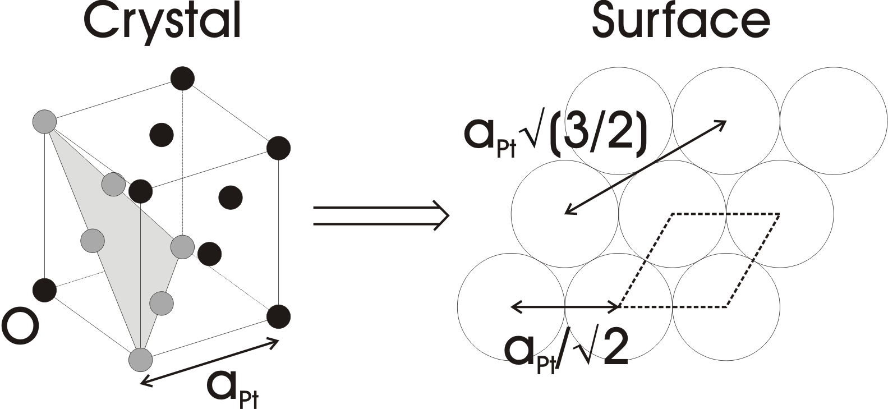
The CO/Pt(111) System
The system consists of a certain coverage of carbon monoxide molecules adsorbed on to a platinum(111) surface.
Pt has a face-centred cubic (f.c.c.) crystal structure.
The (111) surface is formed by cleaving an infinite Pt crystal at a (111) plane. [1]
This forms a hexagonal lattice of Pt atoms.
[1] Zangwill A 1988 Physics at Surfaces (Cambridge: Cambridge University Press)

Slide 4
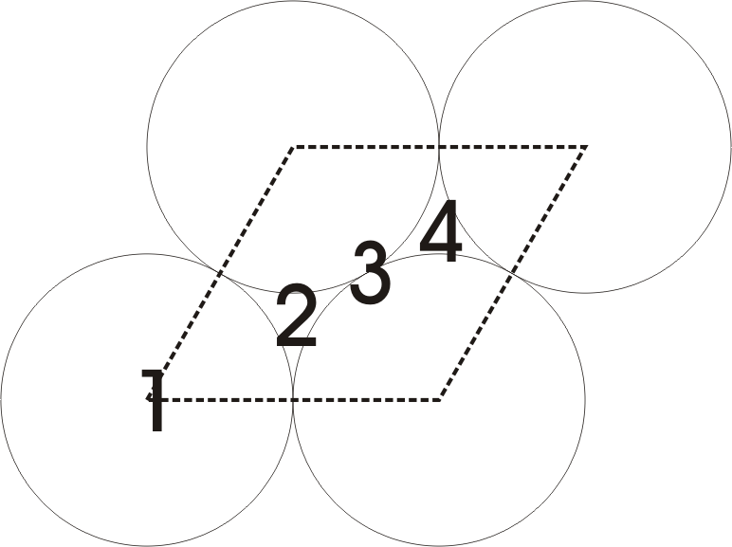
The CO/Pt(111) System
CO coverage is conventionally given the symbol θ, and expressed in units of monolayers: the number of CO adatoms as a fraction of the number of surface Pt atoms.
CO attaches to the Pt surface via chemisorption.[1] This means it forms bonds with the surface.
CO can bind to one of four adsorption sites; 1: top site, 2: f.c.c. hollow, 3: bridge site, 4: hexagonal close-packed (h.c.p.) hollow. Each of these can have a different binding energy; i.e. the energy released in forming the bond between the CO and the surface. [2]
[2] Feibelman P J, Hammer B, Norskov J K, Wagner F, Scheffler M, Stumpf R, Watwe R and Dumesic J 2001 J. Phys. Chem. B 105 4018-25

Slide 5
History
Why study CO/Pt(111)?
  Pt is a very important catalyst.
  This specific system has applications in e.g. catalytic convertors.
  In addition, we can use it to learn about very similar systems in all sorts of other processes – e.g. Fischer-Tropsch synthesis. [3]
Thus it is a very widely studied system, and has been for decades.
These previous studies show coverage-dependent results, including a reduction in binding energy with increasing coverage, e.g. [4]
Low-energy electron diffraction (LEED) patterns in particular also show certain preferred ordered CO layer structures, which change with coverage. [5]
[3] Biloen P and Sachtler W M H 1981 Adv. Catalysis 30 165-216
[4] Yeo Y Y, Vattuone L and King D A 1997 J. Chem. Phys. 106 392-401
[5] Ertl G, Neumann M and Streit K M 1977 Surf. Sci. 64 393-410

Slide 6
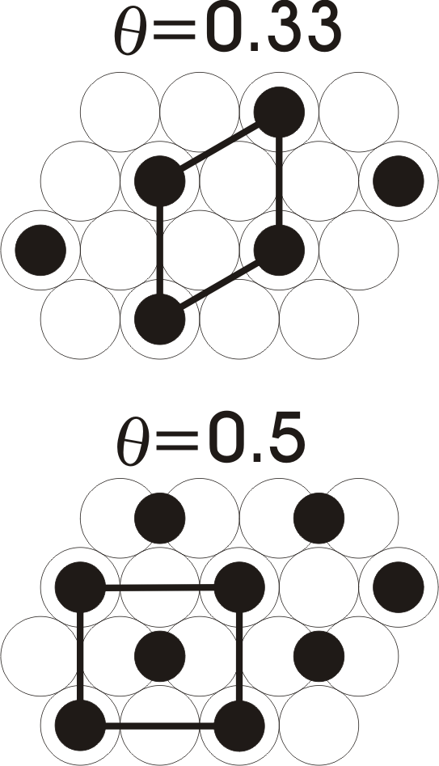
History
Examples of the structures deduced from LEED patterns are the (√3x√3)R30° pattern at θ=0.33, and the c(4x2) pattern at θ=0.5. [5]
It has often been assumed that these results show a pairwise repulsive interaction between CO molecules, with a magnitude depending only on their separation, e.g. [6,7].
This would naturally reduce binding energy for increasing coverage, as CO molecules feel more total average repulsion.
The suggested ordered structures for different coverages maximise inter-CO separations, further suggesting a repulsion.
The suggested strength of this repulsion is often ~40meV for nearest-neighbours. [6,7]
[6] Petrova N V and Yakovkin I N 2002 Surf. Sci. 519 90-100
[7] McEwen J S et al. 2003 Surf. Sci. 545 47-69

Slide 7
History
However, recent results from Alexandrowicz et al. [8] casts some doubt on this assumption.
They appear to show uncorrelated surface diffusion of CO molecules, which can only result from negligible pairwise interactions. Strong interactions result in correlated motion.
To understand how these conclusions were reached, it is necessary to grasp the basics of the intermediate scattering function (ISF), I(ΔK,t).
The measured results of [8] are proportional to this function.
[8] Alexandrowicz G, Kole P R, Lee E Y M, Hedgeland H, Ferrando R, Jardine A P, Allison W and Ellis J 2008 J. Am. Chem. Soc. 130 6789-94

Slide 8
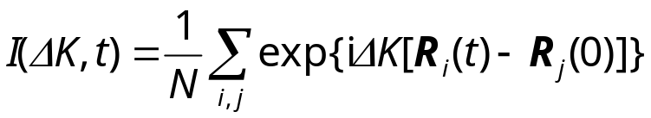
The ISF
The ISF is directly measured by many scattering techniques.
The ISF at a given time can be calculated directly from [8]:
where ΔK is the momentum transfer of the scattering event in the surface plane, R_{i}(t) is the position of particle i at time t, the sum is over all pairs of particles i and j, including i=j, and N is the number of particles.
This is the spatial Fourier transform of the pair correlation function G(r,t), which measures the probability of finding a particle at position r at time t given there was a particle at r=0 when t=0.
With random surface motion (including jump diffusion as investigated here) it decays exponentially with time, with rates determined by correlation lifetimes.

Slide 9
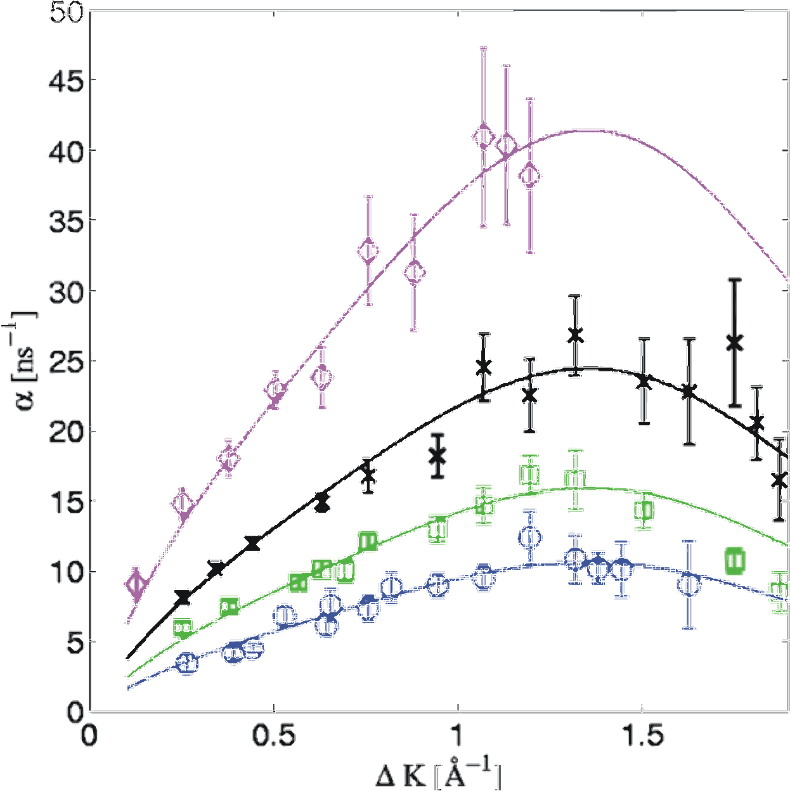
Challenging Results
This figure shows the decay rates of the ISF, the inverse lifetimes, from [8].
Within experimental error, all coverages are fitted with the same polynomial function, simply scaled.
According to [8], if there were correlated motion, certain real-space separations would be longer-lived, giving dips at corresponding ΔK values and peaks at others.
This effect would be highly coverage-dependent, changing the shape of α(ΔK) for higher coverages.
This effect is not seen.
Coverage
Inverse lifetime, α, as a function of the momentum transfer, for different coverages, with fitted polynomial function. (Source: [8]).

Slide 10
Challenging Results
The lack of this coverage-dependent change in the form of α(ΔK) suggests uncorrelated motion.
However, as stated earlier, pairwise forces cause correlated motion. Hence these results suggest a lack of pairwise forces.
Molecular dynamics studies performed in [8] suggest a maximum repulsive interaction of ~10meV between nearest neighbours to reproduce these results, much smaller than previously thought.
This is not strong enough to reproduce the observed reduction in binding energies for higher coverages, so something in this analysis, or that in previous studies, must be wrong.
The question is, what?

Slide 11
Aims and Objectives
The aim of my study was to attempt to shed some light on this discrepancy, using computer simulations to model this system.
The first objective involved performing calculations based on density functional theory (DFT) to attempt to calculate the binding energies and interactions directly.
  Binding energies would be calculated for the 4 different sites.
  Different coverages would be investigated.
  Different adatom separations with fixed coverages would then indicate any repulsions.
The second involved designing a Monte Carlo (MC) simulation of the system, the simulate the ISF results for different interaction strengths.
  For each interaction, the ISF would be calculated over time for various coverages.
  This would then be analysed to calculate inverse lifetimes.

Slide 12
Condensed Matter Theory Group
The project was undertaken within the condensed matter theory group at the University of Bath.
This group has wide ranging interests in solid physics, soft matter physics, surface physics, and network theory.
The project supervisor, Professor David Bird, is actively involved in surface physics research, particularly using DFT methods, hence the first objective fits well within this.
In addition, many other members of the group use Monte Carlo methods to model a variety of systems, and were able to give some advice on the second part of the project.

Slide 13
DFT
DFT is based on two papers by Hohenberg and Kohn [9], and Kohn and Sham [10]. It simplifies the solution of the many-body Schrodinger equation to an iterative procedure which minimises the total energy of a system by changing the electron density.
The original theory only has one approximation, the local density approximation (LDA) [10]. This has since been superseded by the generalized gradient approximation (GGA) [11], which gives much better results.
There are other simplifications used in practice to make calculations tractable, such as the use of plane-wave basis sets to expand the electron wavefunctions and density, and pseudopotentials to represent core electrons. [11]
[9] Hohenberg P and Kohn W 1964 Phys. Rev. 136 B864
[10] Kohn W and Sham L J 1965 Phys. Rev. 140 A1133
[11] Martin R M 2004 Electronic Structure: Basic Theory and Practical Methods (New York: Cambridge University Press)

Slide 14
DFT
Calculations are run with the PW-SCF DFT software package, generally employing ultra-soft pseudopotentials, plane-wave basis sets, and using the GGA.
Results are converged with respect to various parameters, e.g. k-point set size and basis set size, first for free space CO.
The bulk Pt lattice constant is calculated through geometry optimisation (minimising the total energy with respect to positional parameters).
A 1x1 Pt slab supercell (a cell containing a number of primitive unit cells) [11] is set up using this bulk lattice constant, and further convergence tests performed.
Calculations of binding energy differences for the different sites are then made, as well as theoretically for different coverages and separations.

Slide 15
DFT
The vibrational frequency of the C-O bond is found to be 2163±10cm⁻¹, agreeing with previous results. [12]
The bulk modulus of Pt is found to be 238GPa.
The binding site energies are found to be (relative to the top site energy): f.c.c. hollow 38meV, h.c.p. hollow 90meV, and bridge site 267meV, in reasonable agreement with previous data. [13,14]
Unfortunately, at this stage the supercomputer running the calculations went out of service for the remainder of the project, preventing further calculations.
These promising results therefore remain to be extended to larger cells, lower coverages, and different separations, hopefully showing the presence of any interactions.
[12] Goldman A S and Krogh-Jespersen K 1996 J. Am. Chem. Soc. 118 12159-66
[13] Olsen R A, Philipsen P H T and Baerends E J 2003 J. Chem. Phys. 119 4522-8
[14] Gil A, Clotet A, Ricart J M, Kresse G, Garcia-Hernandez M, Rosch N and Sautet P 2003 Surf. Sci. 530 71-86

Slide 16
MC Simulations
Monte Carlo (MC) methods use probabilistic techniques to move between the potential states of a system, aiming to sample them with a distribution as close to reality as possible. [15]
By taking averages of macroscopic properties over these states, estimators of the real values can be found.
Due to their probabilistic nature, they are frequently more efficient than fully simulating the dynamics of a system using for example molecular dynamics. [15]
However, care must be taken when the MC system and dynamics to be used are chosen, so that the results accurately represent the desired real system.
[15] Newman M E J and Barkema G T 1999 Monte Carlo Methods in Statistical Physics (New York: Oxford University Press)

Slide 17
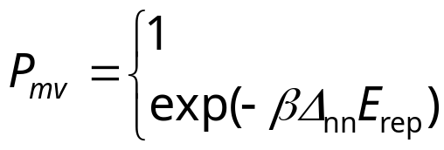
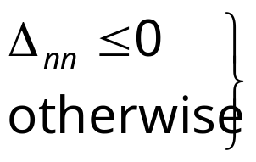
MC Method
The system is set up as follows: CO molecules are allowed to move on a 2D lattice representing only the top site adsorption points, undertaking random moves influenced by a nearest neighbour repulsion, E_{rep}, of varying strengths, and occupied-site exclusion.
A move is selected by randomly choosing a molecule and a nearest neighbour to move to. The probability of a given move being accepted is:
where Δ_{nn} is the change in the number of nearest neighbours of the selected molecule that would be caused by the move, and β is the inverse temperature, 1/k_{B}T.
The system is first set up with molecules at random sites, then allowed to run for a set period, then data recording begins.

Slide 18
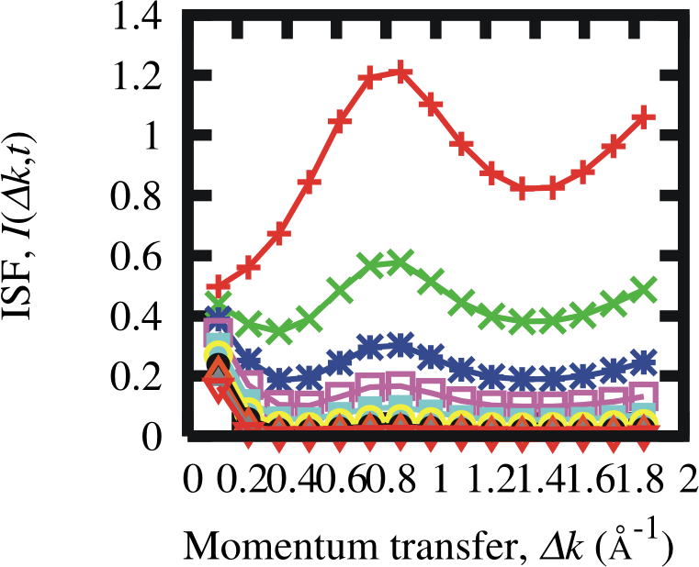
Data Analysis Technique
Fourier transforms of the molecule positions are taken at intervals, multiplying these together gives the same results for the ISF as given earlier.
The resulting ISF along the [112] crystal azimuth (the same as used in [8] ) is shown, with the decay over time apparent.
Next, the decay series over time at each k-point is plotted on a log graph.
Time

Slide 19
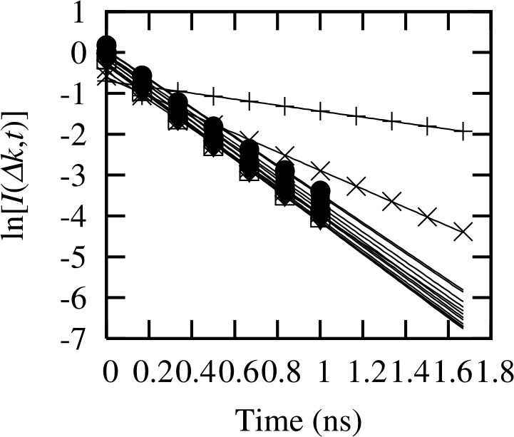
Data Analysis Technique
Next, the decay series over time at each k-point is plotted on a log graph.
The ISF clearly exhibits exponential decay over time, shown by the straight line form of the fits here.
Now the α(ΔK) values are found from the negative gradients of these lines.
These can then be plotted against ΔK to give the final result.
k-points

Slide 20
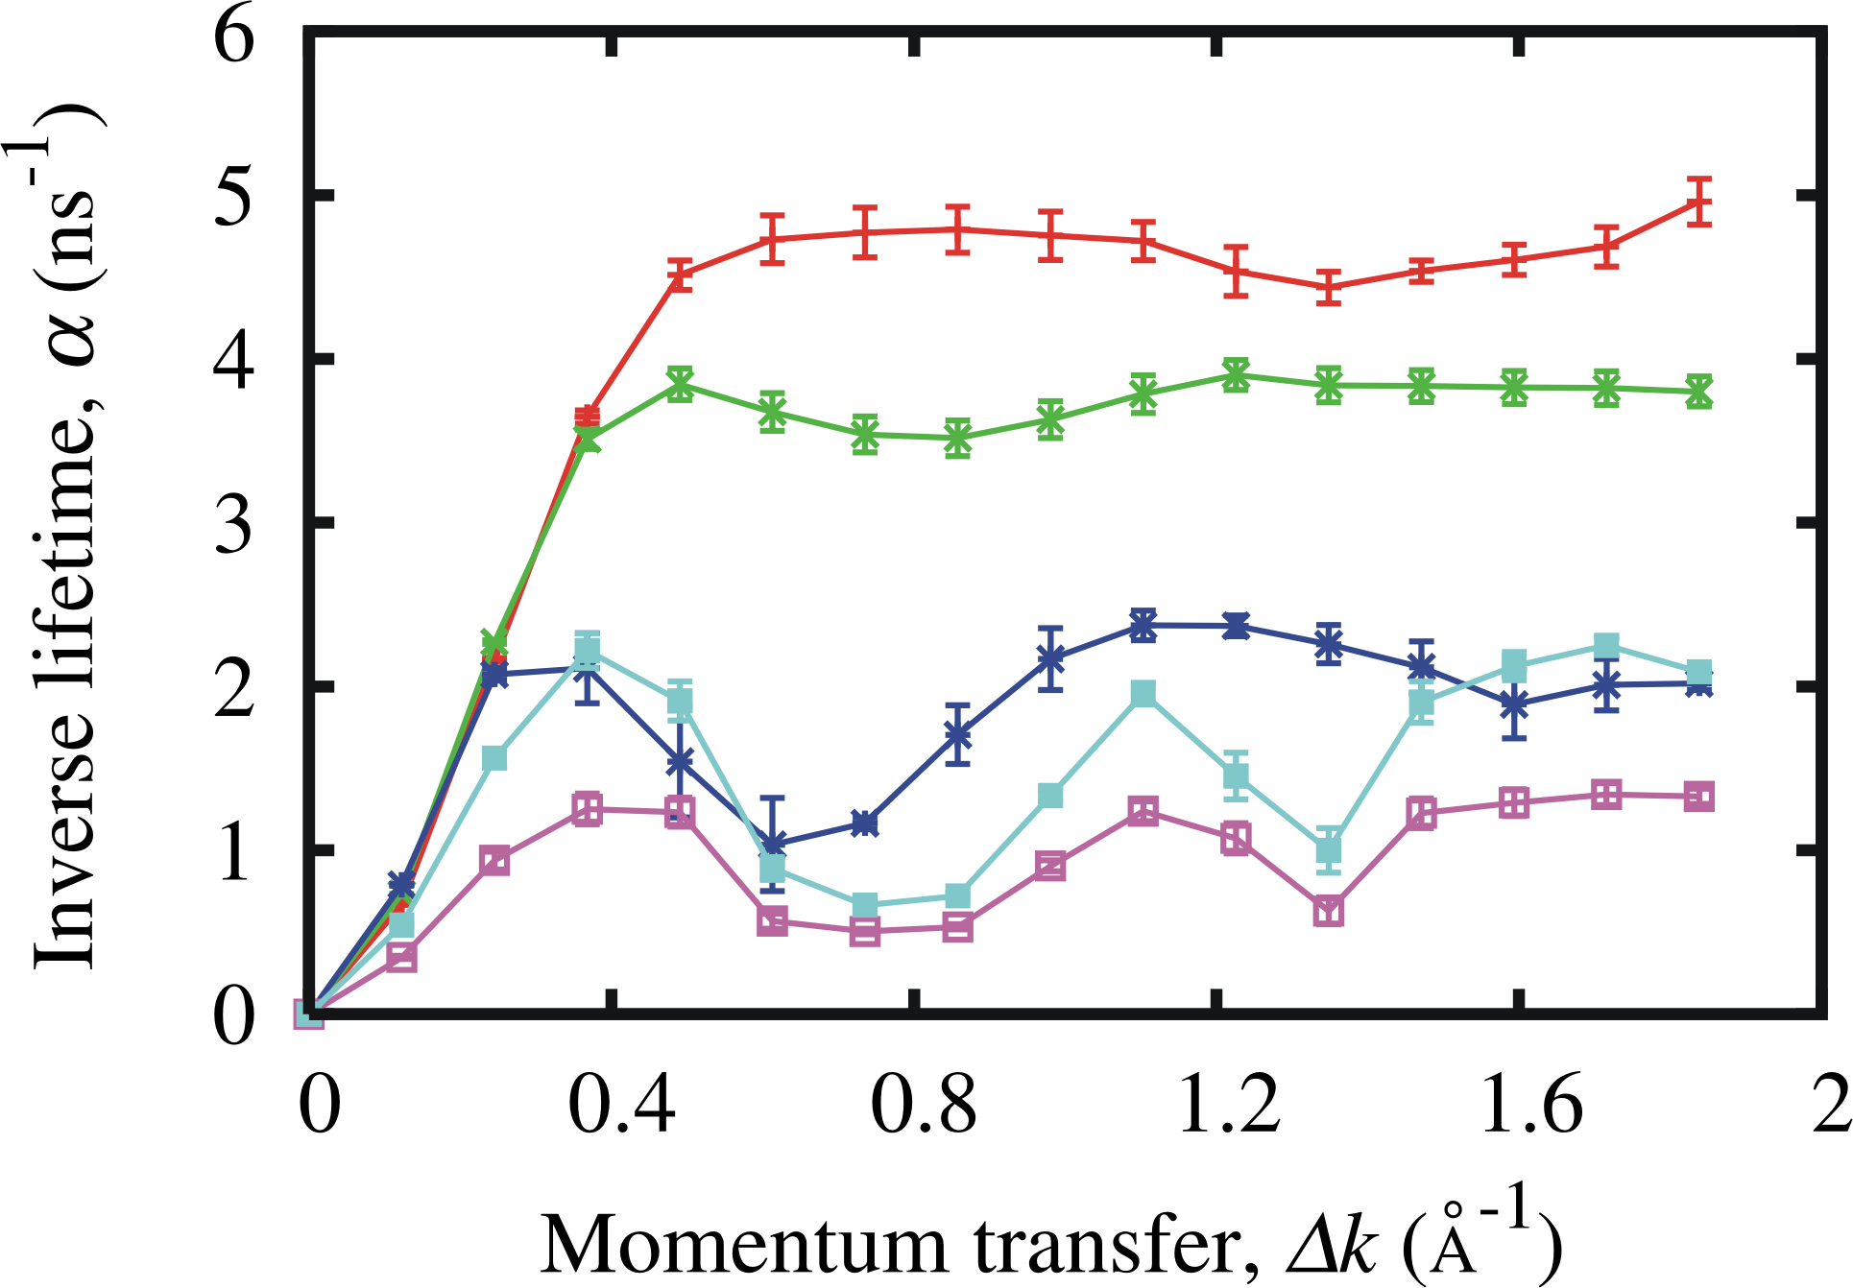
Data Analysis Technique
These can then be plotted against ΔK to give the final result. The plot below is for E_{rep}=100meV with coverages of 0.065, 0.1, 0.2, 0.3 and 0.4.
Coverage

Slide 21
Results
This result clearly shows a coverage-dependent form. Therefore smaller repulsions are tried.
To aid in the analysis, results for the higher coverages are expressed as fractions of the low coverage (θ=0.065) measurement.
Then, according to the theory, uncorrelated motion, which results in a constant scaling factor for different coverages, should give the same fraction across all k-space.
Thus by finding an interaction strength which gives constant fractions for all coverages, a possible limit on the interaction strength can be found.
The next slide shows these fractions plotted for the same coverages as before, with repulsions varying between 0 and 50meV.

Slide 22
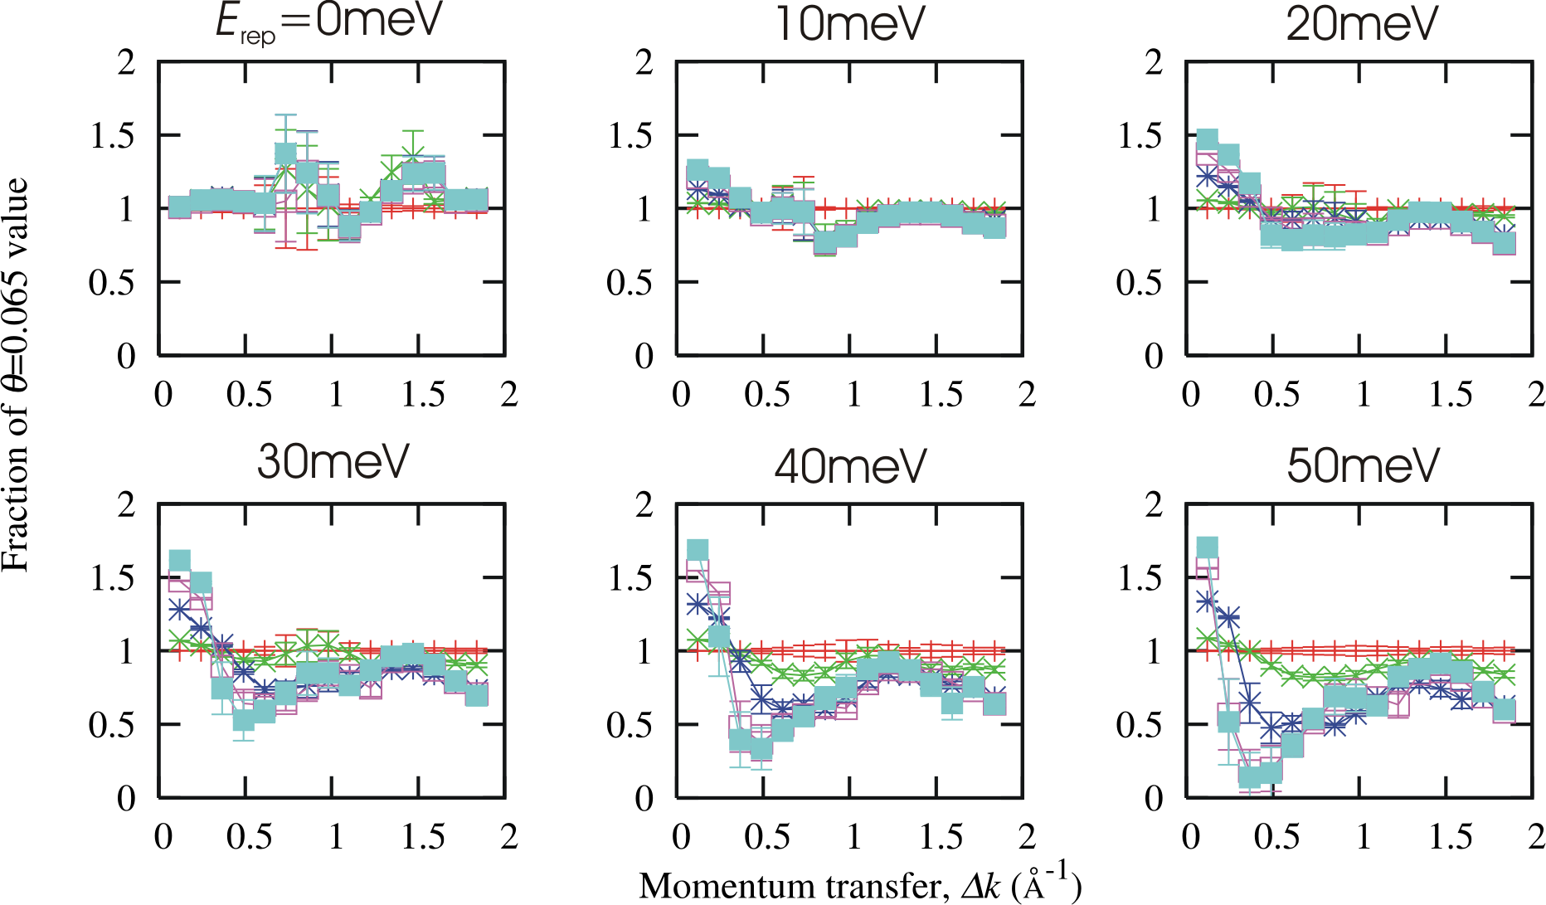
Results
Coverages 0.065 (orange), 0.1 (green), 0.2 (purple), 0.3 (pink) and 0.4 (blue).

Slide 23
Analysis
These results appear to show that a repulsion below 10meV would be required for uncorrelated motion, in good agreement with [8], in disagreement with the value proposed for many models, e.g. [6,7].
This model, however, is very simple. More complex models may give different behaviours.
This model does not give increased inverse lifetimes for increased coverages, as it does not take into account the reduced binding energies for these coverages, which would reduce diffusion energy barriers thus reducing lifetimes.
This would only affect the absolute values of α(ΔK), not the form.
Thus it can be said that, within this simple model, repulsive pairwise interactions of any significant magnitude cannot reproduce the results shown in [8].

Slide 24
Summary
Previous studies of coverage-dependent properties of CO adsorbed on Pt(111) surfaces showed effects which were attributed to a repulsive pairwise interaction between CO molecules.
A new study suggested that this interaction could not in fact exist.
Density functional theory calculations were attempted to directly calculate an interaction strength, but not completed.
Some properties of the system were calculated using DFT, and were found to agree with previous data.
Monte Carlo simulations within a simple top site lattice model with nearest-neighbour repulsions only, seem to agree that the interaction strength must be very small, below 10meV, to produce the results shown in the new study.

Slide 25
Any questions?

Slide 26
Contents
The CO/Pt(111) System
History
The ISF
Challenging Results
Aims and Objectives
Condensed Matter Theory Group
DFT
MC Simulations
MC Method
Data Analysis Technique
Results
Analysis
Summary

Slide 27
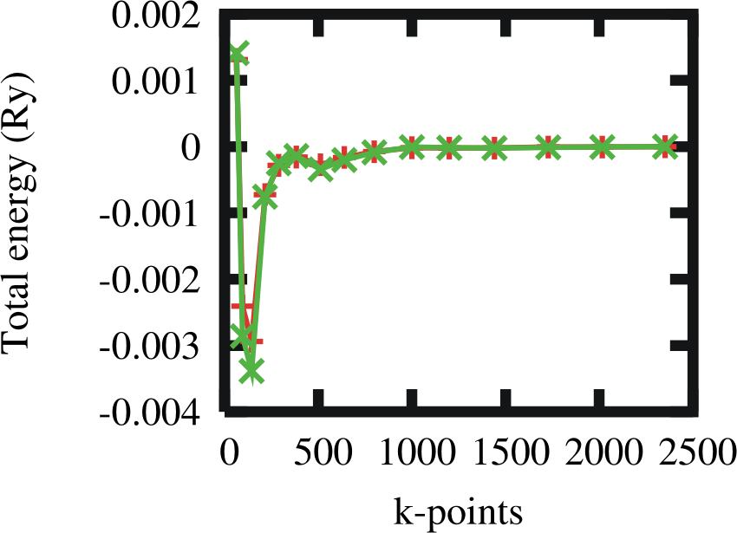

Slide 28
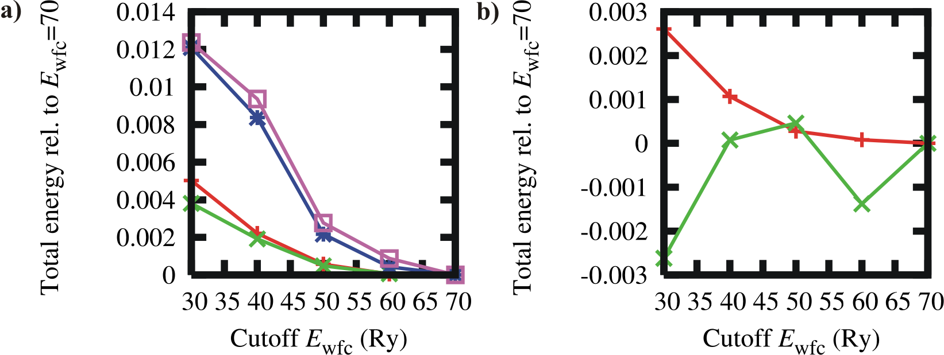

Slide 29
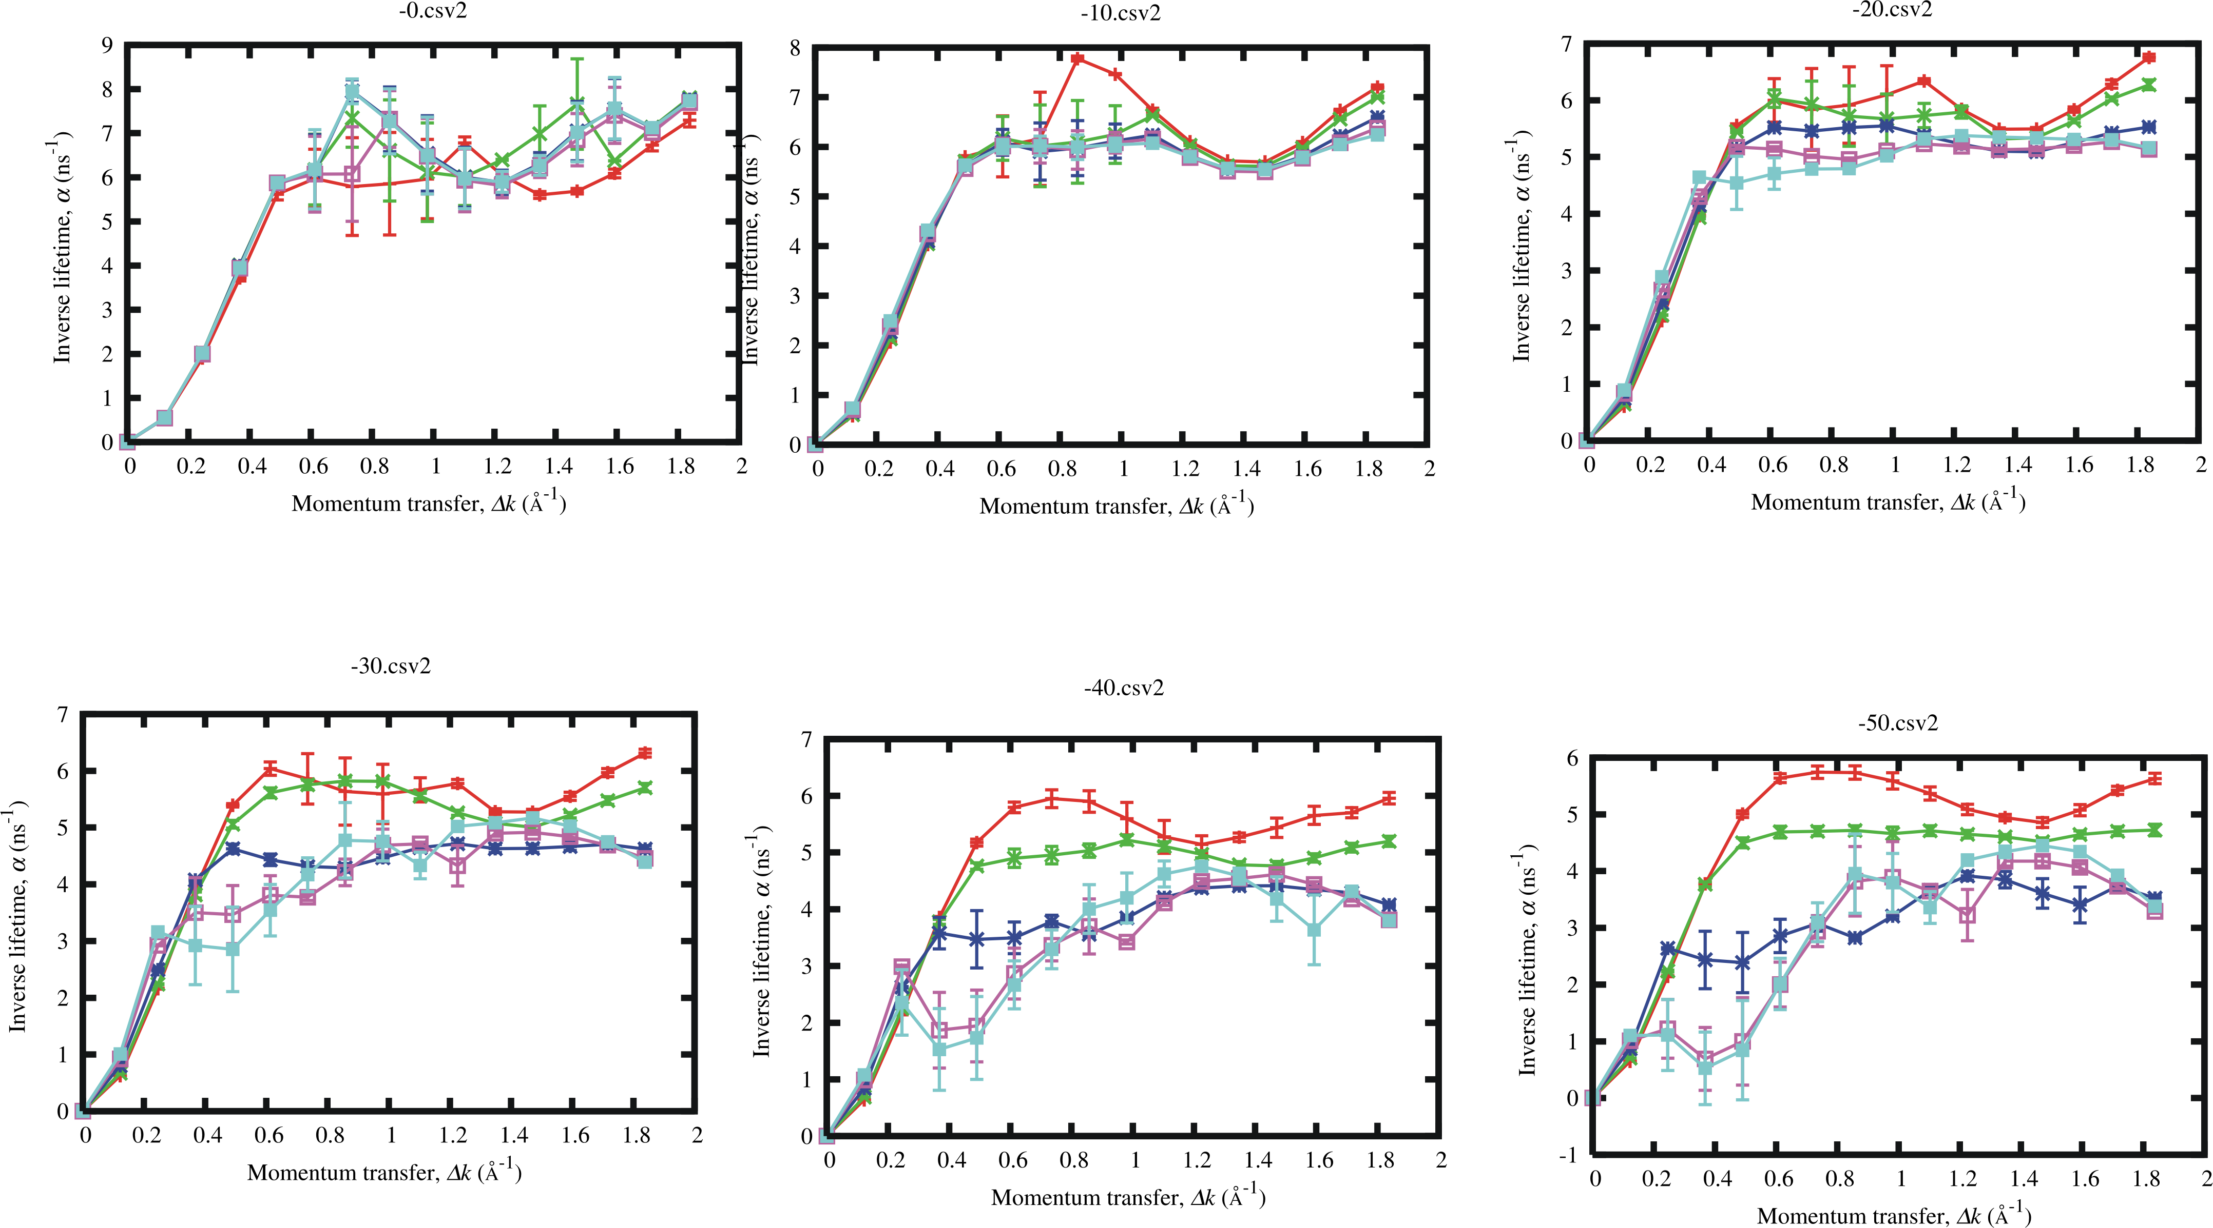

Slide 30
